Slide 1


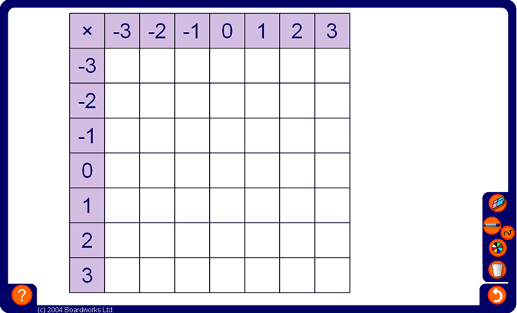


Ordered multiplication square
Notes:
Start by working out the positive number multiplications 3 × 0, 3 × 1, 3 × 2 and 3 × 3.
Ask pupils the answer to 3 × –1, using the number pattern in the table, or using the rules from the previous slide, and fill in the rest of the row to 3 × –3.
Repeat in the same order for the next 2 rows.
Establish that 0 × any number is 0 and fill in this row accordingly.
For the last three rows fill in the first answer by looking at the pattern in the first column and continue along the row.
Before revealing each answer ensure that the question corresponding to that cell has been clearly stated. For example,
What is 1 × –2?
Pupils may then look for number patterns to deduce the answer or use the rules on the previous slide.
Once the table is complete, ask pupils to point out any patterns they notice. Shade the negative numbers blue and shade the positive numbers green.
Ask pupils to use the table to answer some given questions.
For example,
Use the table to work out –2 × –1.

